Slide 1
Does Persistent Homology make SmolVLA more robust?
Topological regularization for Vision-Language-Action models on LIBERO
Master's research project

Slide 2
Motivation & Research Question
• VLA models (SmolVLA) do well on clean benchmarks…
• …but can fail under visual perturbations (viewpoint, lighting, noise).
• Idea: add a Persistent-Homology (PH) loss that matches the topology of
• predicted vs expert action trajectories.
• Question: does PH improve robustness without hurting accuracy or speed?

Slide 3
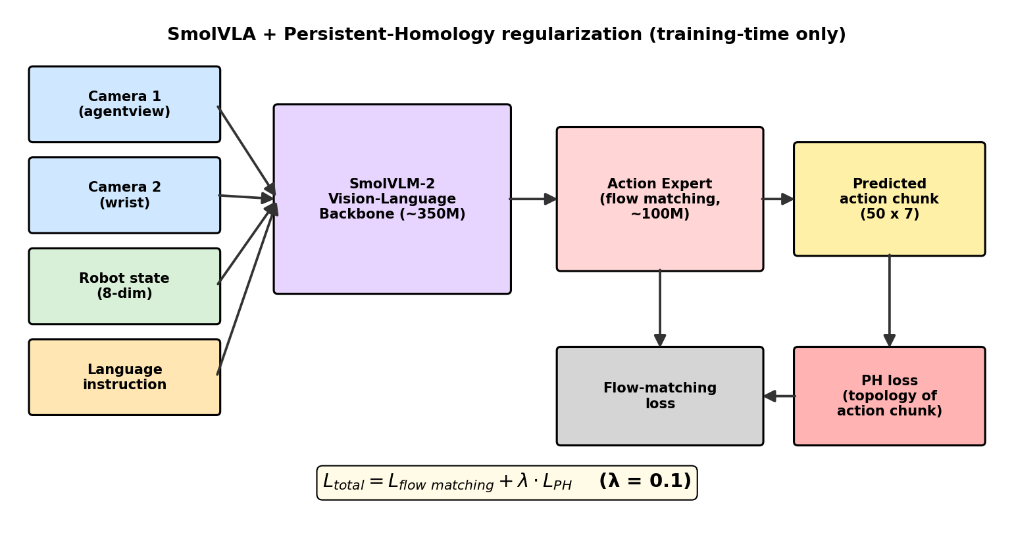
Architecture: SmolVLA + PH regularization
PH is training-time only — inference is unchanged.

Slide 4
Method — PH loss
• Total loss = flow-matching loss + λ · PH loss
• PH loss = difference in sorted top-k pairwise distances of action chunks
• Two-stage training: (1) warm-up head, (2) fine-tune full backbone
• bfloat16, AdamW, gradient checkpointing (Blackwell GPU)
Regularization weight λ = 0.1

Slide 5
Experiment 1 — v1 run
LIBERO-10 & LIBERO-V (visual perturbations)

Slide 6
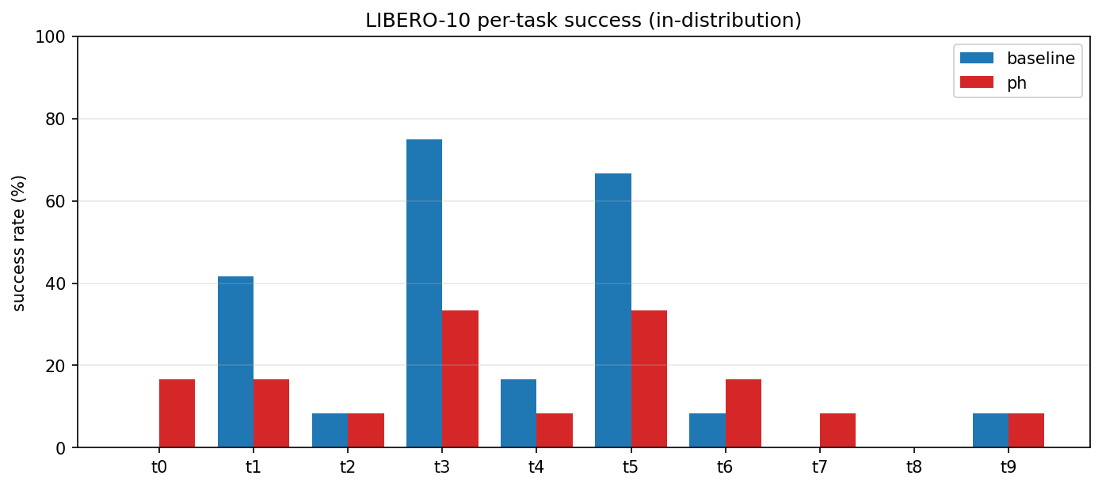
v1 — Success rate (per task)

Slide 7
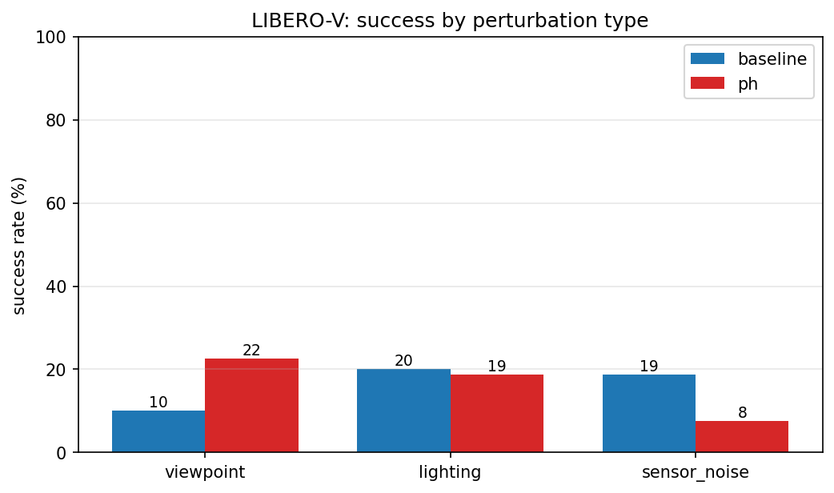
v1 — Robustness to perturbations
viewpoint / lighting / sensor-noise

Slide 8
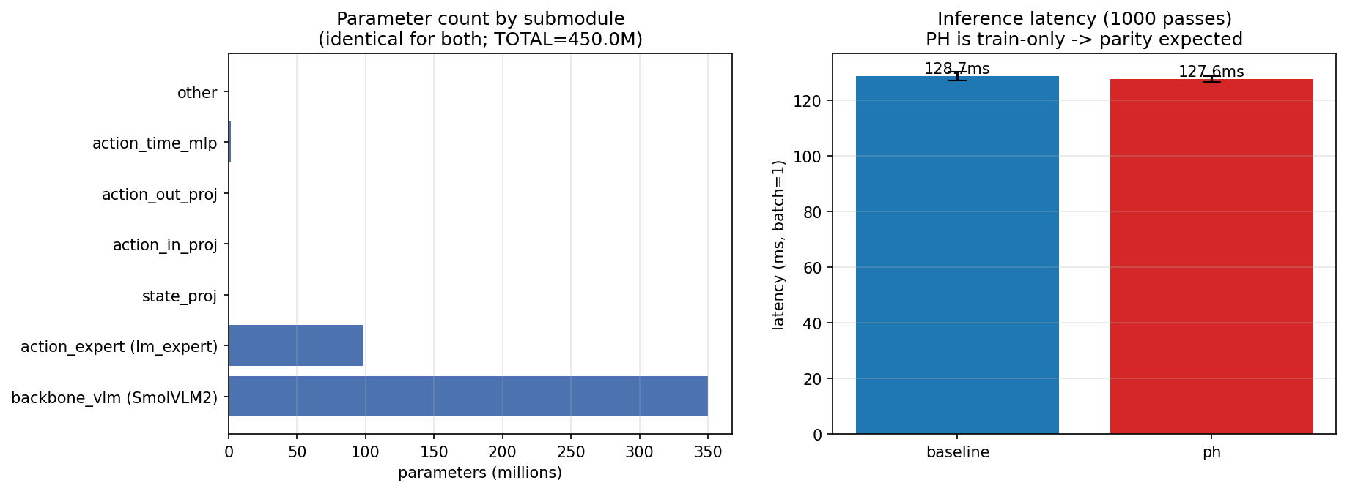
v1 — Latency & Parameters
PH adds zero inference cost (train-only) — latency & params identical

Slide 9
Experiment 2 — Stronger run
Longer training (~6 epochs), 2 suites: LIBERO-10 + LIBERO-Spatial

Slide 10
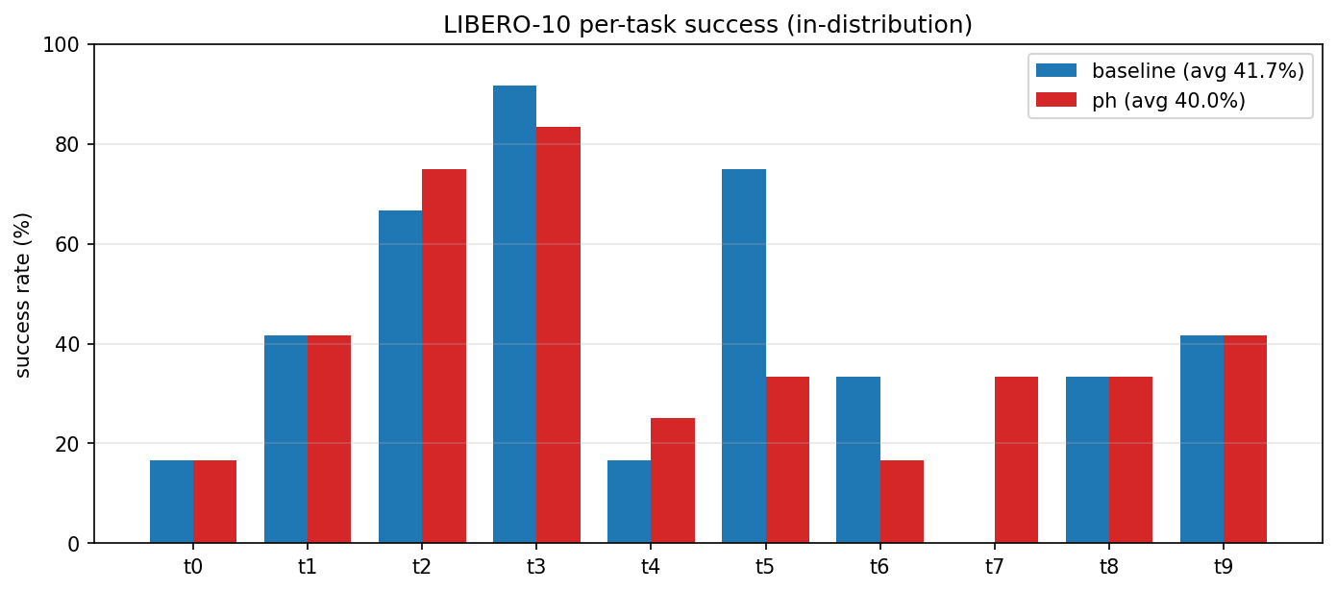
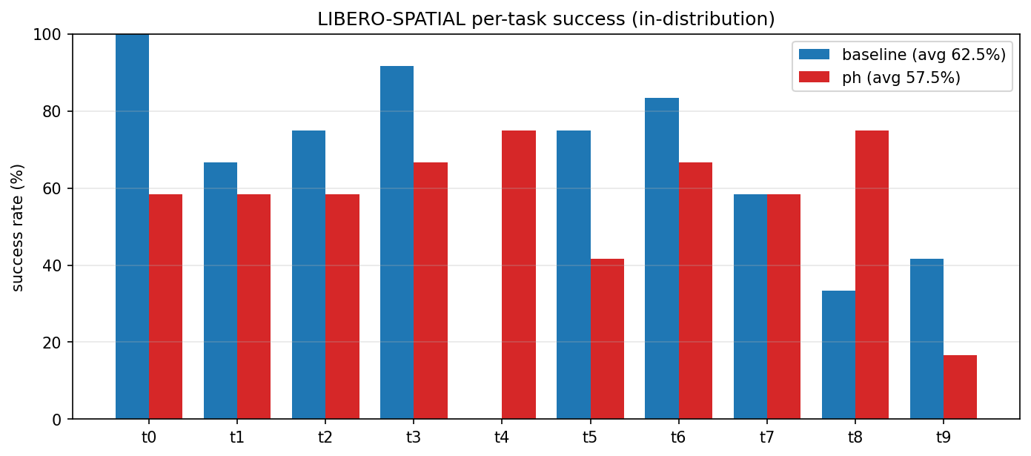
Stronger run — Success rate per task
LIBERO-10 (left) & LIBERO-Spatial (right)

Slide 11
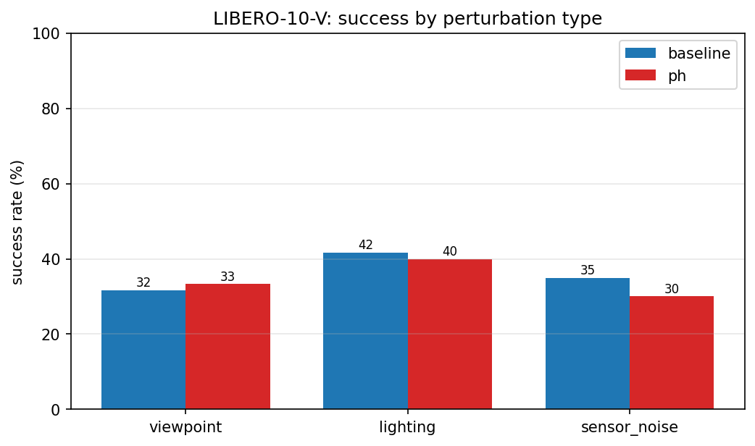
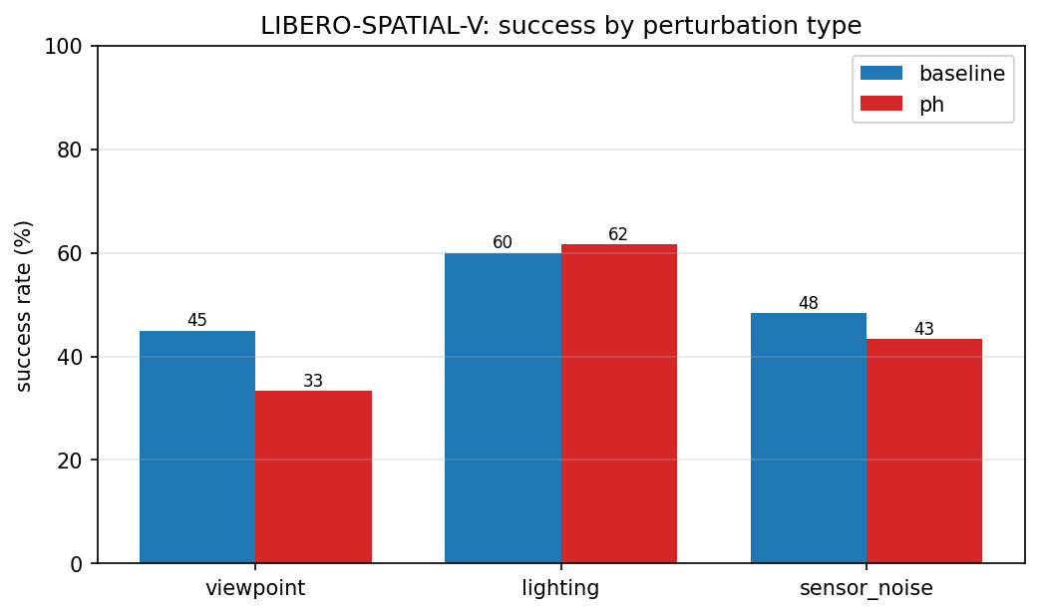
Stronger run — Robustness by perturbation
viewpoint / lighting / sensor-noise

Slide 12
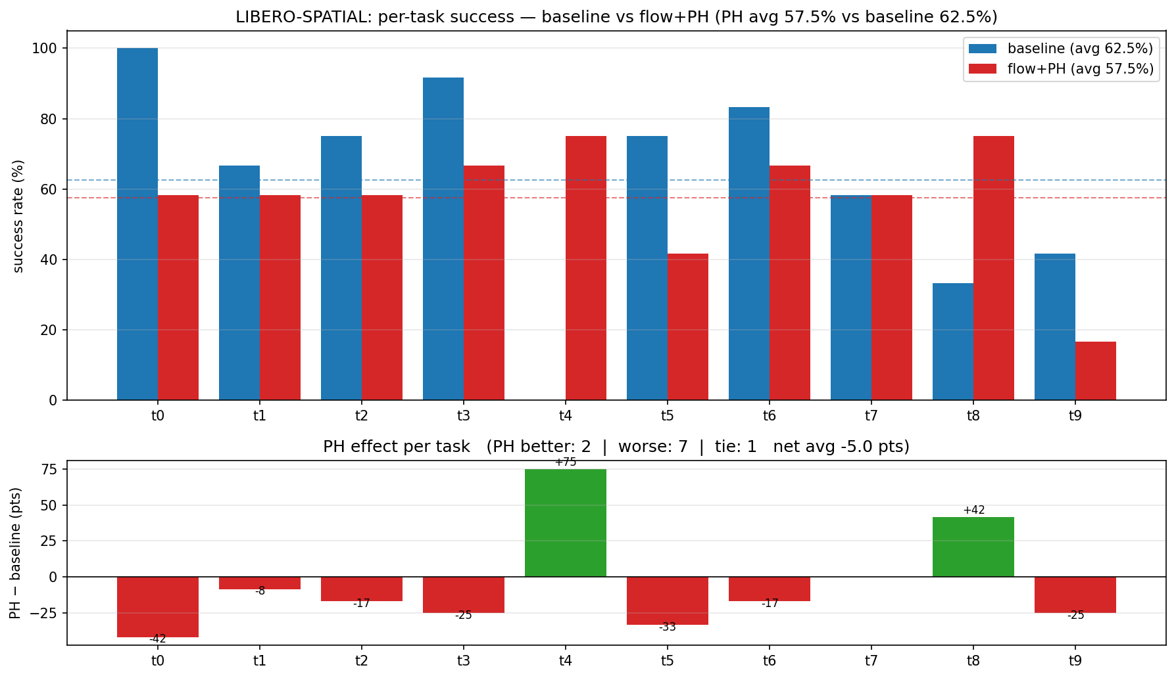
Stronger run — Where PH helps (per-task Δ)
PH wins big on some tasks (e.g. task4), loses on others

Slide 13

Stronger run — Latency & Parameters
Same architecture & latency for both — PH is free at inference

Slide 14
Qualitative result
A task PH solves that flow-matching cannot

Slide 15
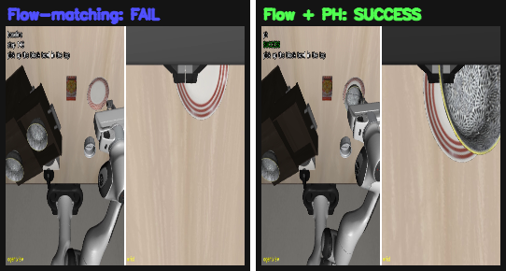
PH succeeds where flow-matching fails (LIBERO-Spatial, task 4)
Left: flow-matching (fails) | Right: flow + PH (succeeds)

Slide 16
Summary
• Built a full SmolVLA + PH training / eval / video pipeline on a Blackwell GPU
• PH is training-time only → zero inference cost (latency & params unchanged)
• Robustness vs accuracy shows a trade-off controlled by λ
• PH can solve specific tasks the baseline cannot (qualitative win)
λ = 0.1 throughout

